Slide 1

CLAP SWITCH
Kshitija Giradkar 2023-IMT-044
Niharika Saxena 2023-IMT-052
Shreya Pandey 2023-IMT-074
Notes:
NOTE:
To change the image on this slide, select the picture and delete it. Then click the Pictures icon in the placeholder to insert your own image.

Slide 2
Introduction: Clap Switch
CLAP SWITCH is a switch which can switch on/off any electrical circuit by the sound of the clap. The basic idea of clap switch is that the electric microphone picks up the sound of your claps, coughs and the sound of books knocked off the table. It produces a small electrical signal. This circuit is used to make the light ON through a clap sound but it can work through any kind of same pitch sound. The essential components used to build this project are electric microphone as a sound sensor. The main function of this device is to change the energy of sound to electrical. This circuit turns ‘ON’ light for the first clap. For the next clap, the light turns OFF. This circuit works with 9V voltage. It is generally used for a light, television, radio, or similar electronic device that the person will want to turn on/off from bed.

Slide 3
Basic Principle
The basic principle of this clap switch circuit is that it converts sound signal into electrical energy. The input component is a microphone that receives clap sound as input and converts it to electrical pulse. The basic idea of clap switch is that the electric microphone picks up the sound of claps and produces a small electrical signal.
This circuit is constructed using basic electronic components like resistors, capacitors, battery, LED and an IC555 timer.
This working of this circuit is based on converting sound energy to electrical energy. Basically, this is a sound-operated switch.

Slide 4
Circuit Elements
Resistors like 1k, 47k, 4.7k, 470 ohms & 330 ohms
Battery – 9V
Capacitors – 100nF and 100uF
IC555 Timer
Microphone
LED
BC547 transistors – 2

Slide 5
IC 555 Timer
The IC 555 timer is a popular integrated circuit widely used in electronics. Imagine it as a tiny electronic brain that performs timing functions, similar to a stopwatch but with the ability to control electronic circuits.
It has three main components: a threshold comparator, a trigger comparator, and a flip-flop. The threshold comparator compares the voltage at the threshold pin to a reference voltage, and when the threshold voltage is greater, it triggers the flip-flop to change its output state. Similarly, the trigger comparator compares the voltage at the trigger pin to the reference voltage, and when the trigger voltage is lower, it triggers the flip-flop again, changing the output state.
By connecting resistors and capacitors to certain pins of the IC, we can manipulate the timing intervals. For example, if we connect a resistor and a capacitor to the chip, we can create a circuit that turns an LED on and off at specific intervals. This is useful for creating blinking lights, timing circuits, and other applications. So basically, the 555 timer IC is a versatile component that allows us to create timing circuits, providing control over electronic devices in a variety of applications.

Slide 6
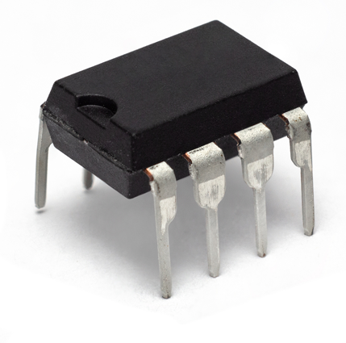
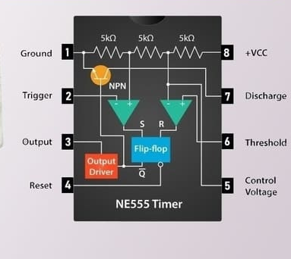
IC 555 TIMER PINOUT

Slide 7
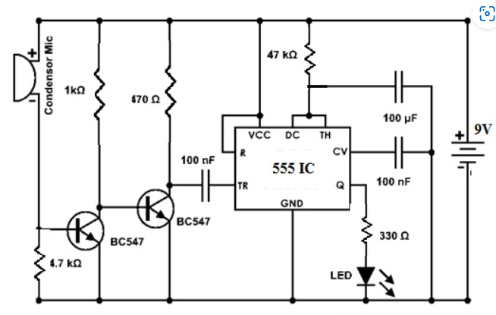
Circuit Diagram

Slide 8
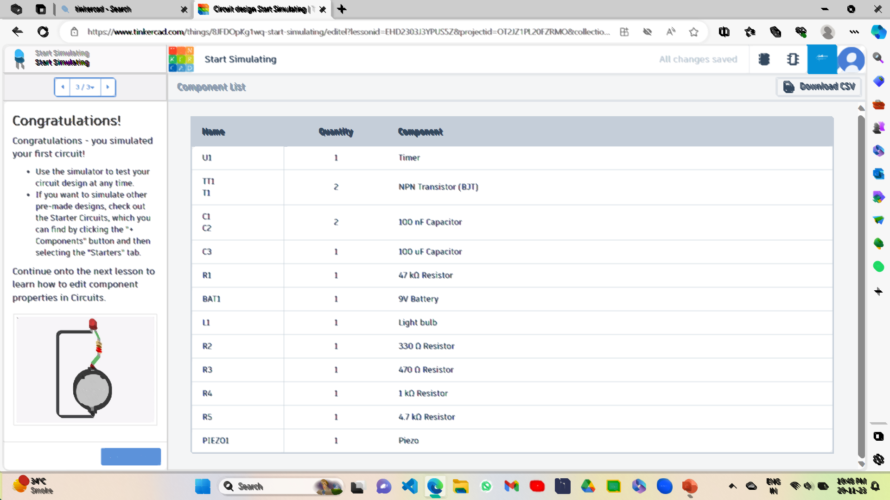
Circuit Elements for Simulation

Slide 9
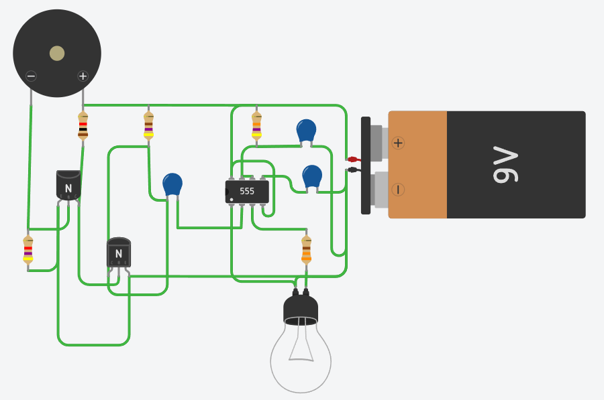
Circuit Simulation Diagram
Simulation Link

Slide 10
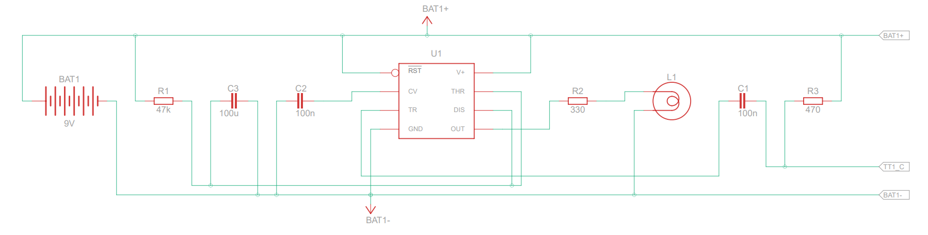
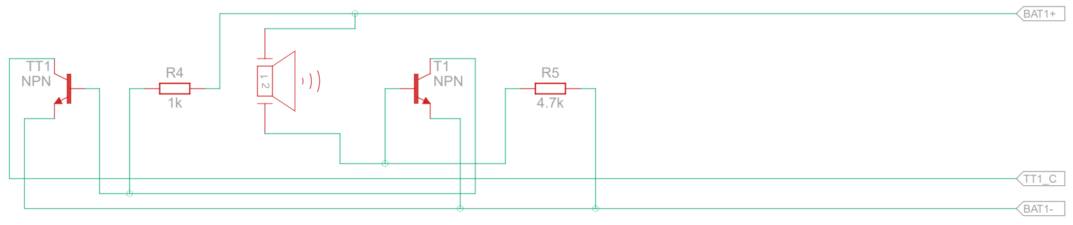
Schematic Circuit Simulation Diagram

Slide 11
Working of the circuit
Clap switch is a circuit that can switch ON & OFF a light, fan, radio etc. by the sound of clap. This circuit uses a sound-activated sensor as an input to detect the clap sound & generates the output by processing the input into the circuit. Once the clap sound is provided to the mic, then it gets electrical energy & turns ON LED. After some time, the LED will automatically be turned OFF. By changing the 100nF capacitor value, the activated LED timer can be modified because it is connected through the IC 555 timer. The main function of this is to generate a signal.
This circuit doesn’t use any kind of switch to control the circuit.
Once the battery is connected to the circuit then the circuit will be activated. Once the sound input is given to the circuit by clapping, then the electrical signals are sent to the IC that generates the signal to activate the LED.

Slide 12
Advantages and Disadvantages
ADVANTAGES
The primary application involves an elderly or mobility-impaired person.
We can turn something (e.g. a lamp) on and off from any location in the room (e.g. while lying in the bed) simply by clapping our hands.
Low cost and reliable circuit.
Complete elimination of man power.
Energy efficient.
DISADVANTAGES
It is generally awkward to have to clap one’s hands to turn something on or off and it is simpler for most cases to use a traditional light switch.
Unless we use a filter in the circuit , it is not that advantageous. So that circuit activates only for clap of particular frequencies and then it becomes accurate.

Slide 13
Applications
Clap activated switch device will serve well in different sound-controlled applications.
Clap switch is generally used for a light, television, fan, radio or similar electronic device that the person will want to turn on/off from bed.
The primary application involves an elderly or mobility-impaired person.
This circuit functions on using the sound energy provided by the clap which is converted into electrical energy by condenser microphone. Hence it is energy efficient.

Slide 14
Conclusion
The clap activated switching device functions properly by responding to claps at about three to four meter away and finger tap sounds at very close range, since both are low frequency sounds and produce the same-pulse wave features. The resulting device has a good reliability and is relatively cheap. This circuit is very useful in field of electronic circuits. By using some modification, its area of application can be extended in various fields. E.g. it can be used to raise an alarm in security system with a noise.

Slide 15

Thank you ☺
Kshitija Giradkar 2023-IMT-044
Niharika Saxena 2023-IMT-052
Shreya Pandey 2023-IMT-074
Notes:
NOTE:
To change the image on this slide, select the picture and delete it. Then click the Pictures icon in the placeholder to insert your own image.

